Slide 1


Java SE
(Core JAVA)
Lecture-12

Slide 2
Today’s Agenda
Two dimensional arrays
Rectangular 2D array
Jagged 2D array.

Slide 3
Two Dimensional Arrays
Rectangular 2D Arrays
Every row has same number of columns.
Jagged 2D
Arrays
Every row can have different numbers of column.

Slide 4
Rectangular 2D Arrays
Creating array reference
<data type> [ ] [ ] <array reference>;
Or
<data type> <array reference>[ ] [ ];
Example - int [ ] [ ] arr;
Creating array object
<array reference>=new <data type>[size][size];
Example – arr=new int[3][4];
* “arr” is a reference to an array of references to an array of integer.
Let us understand this line through diagrammatic representation

Slide 5
Rectangular 2D Arrays
* “arr” is a reference to an array of references to an array of integer.
0
1
2
3
0
0
0
0
2000
1000
0
2000
0
1
2
3
1000
arr
1
3000
0
0
0
0
2
4000
3000
0
1
2
3
0
0
0
0
4000

Slide 6
What will be the output for this…
int [ ] [ ] arr=new arr[3][4];
System.out.println(arr.length);
System.out.println(arr[0].length);
System.out.println(arr[0][0].length);
3
4
Error

Slide 7
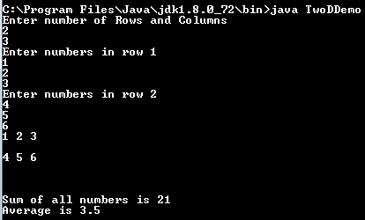
Exercise
WAP to create a rectangular 2D array of the row and column size mentioned by the user. Now, ask the user to input values in that array and finally display these values in matrix form as well as their sum and average.
Sample output

Slide 8
Solution
import java.util.Scanner;
class TwoDDemo
{
public static void main(String [] args)
{
Scanner kb=new Scanner(System.in);
int [][] arr;
int sum=0;
System.out.println("Enter number of Rows and Columns");
int r=kb.nextInt();
int c=kb.nextInt();
arr=new int[r][c];
for(int i=0;i<arr.length;i++)
{
System.out.println("Enter numbers in row "+(i+1));
for(int j=0;j<arr[0].length;j++)
{
arr[i][j]=kb.nextInt();
sum=sum+arr[i][j];
}
}
for(int i=0;i<arr.length;i++)
{
for(int j=0;j<arr[0].length;j++)
{
System.out.print(arr[i][j]+" ");
}
System.out.println("\n");
}
System.out.println("\n\nSum of all numbers is "+sum+"\nAverage is "+((float)sum/(r*c)));
}
}

Slide 9
Jagged 2D Arrays
Syntax :-
<data type> [ ] [ ] <array reference>;
<array reference>=new <data type>[size][ ];
Example –
int [ ] [ ] arr;
arr=new int [3][ ];
arr[0]=new arr[6];
arr[1]=new arr[4];
arr[]=new arr[5];
0
1
2
3
4
5
0
0
0
0
0
0
1000
2000
1000
0
2000
0
1
2
3
arr
1
3000
0
0
0
0
2
4000
3000
0
1
2
3
4
0
0
0
0
0
4000

Slide 10
Initializing a Jagged array
int arr=new int[2][ ];
arr[0]=new int[2];
arr[1]=new int[3];
arr[0][0]=10;
arr[0][1]=20;
arr[1][0]=30; // and so on...
int [ ][ ] arr= new int [ 2][ ];
arr[0]= new int[ ]{10,20,30,40};
arr[1]= new int[ ]{50,60,70};
int [ ][ ] arr={{10,20,30},{50,60},{70,80,90}};

Slide 11
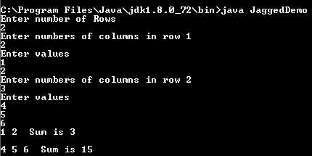
Exercise
WAP to create a jagged array where row and column sizes are to be accepted from the user. Now, print all the values of jagged array along with row wise sum.
Sample output

Slide 12
Solution
import java.util.Scanner;
class JaggedDemo
{
public static void main(String [] args)
{
Scanner kb=new Scanner(System.in);
int [][] arr;
System.out.println("Enter number of Rows");
int r=kb.nextInt();
arr=new int[r][];
for(int i=0;i<arr.length;i++)
{
System.out.println("Enter numbers of columns in row "+(i+1));
int c=kb.nextInt();
arr[i]=new int[c];
System.out.println("Enter values");
for(int j=0;j<arr[i].length;j++)
{
arr[i][j]=kb.nextInt();
}
}
for(int i=0;i<arr.length;i++)
{
int sum=0;
for(int j=0;j<arr[i].length;j++)
{
sum=sum+arr[i][j];
System.out.print(arr[i][j]+" ");
}
System.out.println(" Sum is "+sum+"\n");
}
}
}

Slide 13

End Of Lecture 12
For any queries mail us @: scalive4u@gmail.com
Call us @ : 0755-4271659, 7879165533
Agenda for Next Lecture:
Object Oriented Progamming
Creating Classes
Creating Objects

